Slide 1
Entity Recognition
atjahyanto@gmail.com

Slide 2
Entity Recognition
Find and mark pieces of text (tokens or phrases) that represent important entities or information.
Entities here are not limited to names of people or places, but can be:
Numbers
Dates
Units
Products
Specific concepts
…

Slide 3
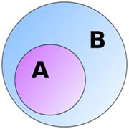
Named Entity Recognition (NER)
A → NER
B → ER
A specific subset of Entity Recognition.
NER focuses on detecting Named Entities, which are entities typically names or special terms that can be categorized into specific classes.
Example:
Sentence → "Barack Obama was born in Hawaii in 1961."
Barack Obama → Person
Hawaii → Location
1961 → Date
Standard categories in NER typically include:
PER → Person (person's name)
ORG → Organization (organization/company name)
LOC → Location (place/geography name)
DATE/TIME → Date/time
MONEY → Amount of money
PERCENT → Percentage

Slide 4
Entity Recognition vs Named Entity Recognition (NER)

Slide 5
Types of entities

Slide 6
How to recognize entity?
Rule-based / Regex Matching.
Use predefined patterns (regular expressions, keyword dictionaries).
Dictionary / Gazetteer Lookup.
Match words against predefined lists (e.g., list of cities, universities, study programs).
Part-of-Speech (POS) Tagging + Heuristics.
Identify nouns, proper nouns, etc. as potential entity candidates.
Named Entity Recognition (NER) with Pretrained Models.
Use NLP models (e.g., spaCy, HuggingFace Transformers, BioBERT).
Custom NER Training.
Train a model with labeled examples for domain-specific entities (e.g., admission path, product names).
Statistical / ML Methods.
Sequence labeling with algorithms like CRF (Conditional Random Fields).
Deep Learning / Transformers.
Contextual embeddings (BERT, RoBERTa, GPT) + fine-tuning for NER.
Hybrid Approach.
Combine rules + ML models.

Slide 7
Rule-based / Regex Matching
Manually creating rules to recognize specific entities using regular expressions (regex) to detect matching text patterns.
This approach doesn't learn from data like machine learning, so it's only suitable if the entities have a clear pattern.

Slide 8
Rule-based / Regex Matching
Works best when entities follow strict, repetitive patterns.

Slide 9
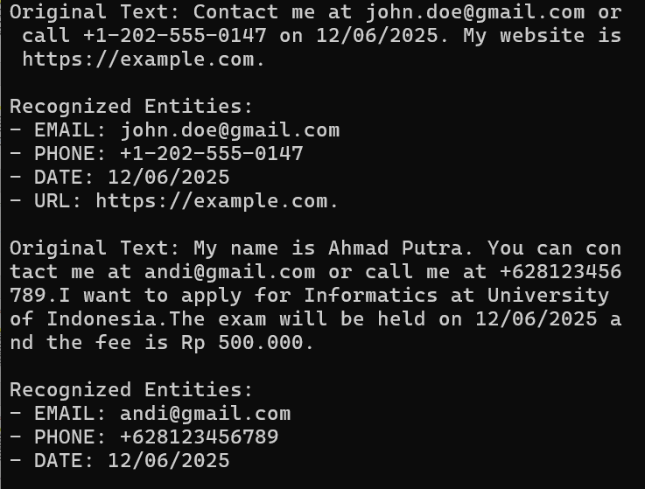
Regex-based Entity Recognition
import re
# Contoh teks
texts = [
"Contact me at john.doe@gmail.com or call +1-202-555-0147 on 12/06/2025. My website is https://example.com.",
"My name is Ahmad Putra. You can contact me at andi@gmail.com or call me at +628123456789.I want to apply for Informatics at University of Indonesia.The exam will be held on 12/06/2025 and the fee is Rp 500.000."
]
# Kumpulan pola regex untuk entity
patterns = {
"EMAIL": r"[A-Za-z0-9._%+-]+@[A-Za-z0-9.-]+\.[A-Za-z]{2,}",
"PHONE": r"\+?\d[\d -]{8,}\d",
"DATE": r"\b\d{1,2}[/-]\d{1,2}[/-]\d{2,4}\b",
"URL": r"https?:\/\/[^\s]+",
}
# Fungsi Entity Recognition dengan Regex
def regex_entity_recognition(text, patterns):
entities = []
for label, pattern in patterns.items():
matches = re.findall(pattern, text)
for match in matches:
entities.append({"entity": label, "value": match})
return entities
# ============== Jalankan ER
for text in texts:
entities = regex_entity_recognition(text, patterns)
# Tampilkan hasil
print("Original Text:", text)
print("\nRecognized Entities:")
for ent in entities:
print(f"- {ent['entity']}: {ent['value']}")
print ()

Slide 10
Dictionary / Gazetteer Lookup
This technique works by matching words or phrases in the text against a pre-prepared word list (dictionary/gazetteer).
Typically used for domain-specific entities whose list is already known, for example:
City → Jakarta, Bandung, Surabaya
University → University of Indonesia, ITB, UGM, ITS
Study Program → Informatics, Information Systems, Medicine, Law
Lack of flexibility: unable to recognize new entities outside the list.
Difficulty handling spelling variations (e.g., Univ. Indonesia vs. Universitas Indonesia).

Slide 11
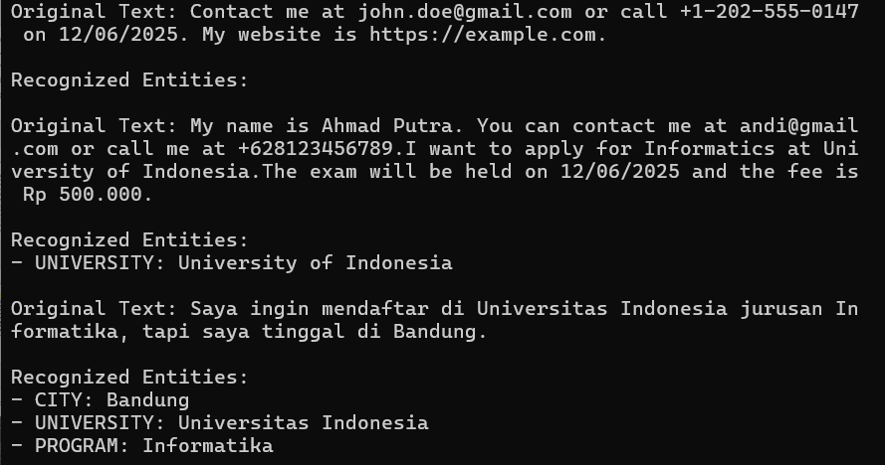
Dictionary / Gazetteer Lookup
# Daftar entity (dictionary / gazetteer)
cities = ["Jakarta", "Bandung", "Surabaya"]
universities = ["Universitas Indonesia", "University of Indonesia", "Institut Teknologi Bandung", "Universitas Gadjah Mada"]
programs = ["Informatika", "Kedokteran", "Hukum"]
# Contoh teks input
texts = [
"Contact me at john.doe@gmail.com or call +1-202-555-0147 on 12/06/2025. My website is https://example.com.",
"My name is Ahmad Putra. You can contact me at andi@gmail.com or call me at +628123456789.I want to apply for Informatics at University of Indonesia.The exam will be held on 12/06/2025 and the fee is Rp 500.000.",
"Saya ingin mendaftar di Universitas Indonesia jurusan Informatika, tapi saya tinggal di Bandung."
]
# Fungsi Entity Recognition berbasis dictionary
def dictionary_entity_recognition(text, cities, universities, programs):
entities = []
for city in cities:
if city in text:
entities.append({"entity": "CITY", "value": city})
for univ in universities:
if univ in text:
entities.append({"entity": "UNIVERSITY", "value": univ})
for prog in programs:
if prog in text:
entities.append({"entity": "PROGRAM", "value": prog})
return entities
# ============= Jalankan
for text in texts:
entities = dictionary_entity_recognition(text, cities, universities, programs)
# Tampilkan hasil
print("Original Text:", text)
print("\nRecognized Entities:")
for ent in entities:
print(f"- {ent['entity']}: {ent['value']}")
print ()

Slide 12
Part-of-Speech (POS) Tagging + Heuristics
POS Taging, the process of assigning a word class label to each token, for example, noun (NN), verb (VB), adjective (adj/JJ).
Heuristics → additional rules that we create based on simple logic. For example:
Common noun (NN) + capital letter → candidate name of person or place.
Plural noun (NNS) after a verb → candidate object.
POS NNP (Proper Noun) → often considered an entity name of an organization, location, or person.
By combining POS tagging and heuristics, we can detect entities without large pretrained models like BERT/NER.

Slide 13
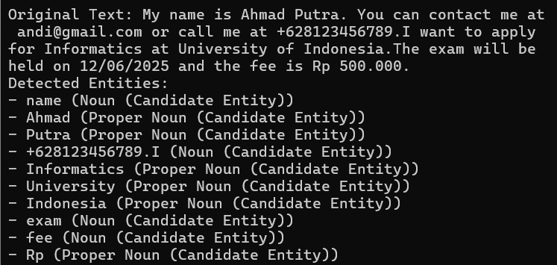

Part-of-Speech (POS) Tagging + Heuristics
import spacy
# Load spaCy English model
nlp = spacy.load("en_core_web_sm")
# Contoh teks input
texts = [
"Contact me at john.doe@gmail.com or call +1-202-555-0147 on 12/06/2025. My website is https://example.com.",
"My name is Ahmad Putra. You can contact me at andi@gmail.com or call me at +628123456789.I want to apply for Informatics at University of Indonesia.The exam will be held on 12/06/2025 and the fee is Rp 500.000.",
"Saya ingin mendaftar di Universitas Indonesia jurusan Informatika, tapi saya tinggal di Bandung."
]
def pos_based_entity_recognition(text: str):
doc = nlp(text)
entities = []
for token in doc:
# Heuristik: proper noun → kandidat Person/Organization/Location
if token.pos_ == "PROPN":
entities.append({"token": token.text, "label": "Proper Noun (Candidate Entity)"})
# Heuristik: common noun → kandidat General Entity
elif token.pos_ == "NOUN":
entities.append({"token": token.text, "label": "Noun (Candidate Entity)"})
return {"original_text": text, "entities": entities}
# ============= Jalankan
for text in texts:
result = pos_based_entity_recognition(text)
print("Original Text:", result["original_text"])
print("Detected Entities:")
for ent in result["entities"]:
print(f"- {ent['token']} ({ent['label']})")
print ()

Slide 14
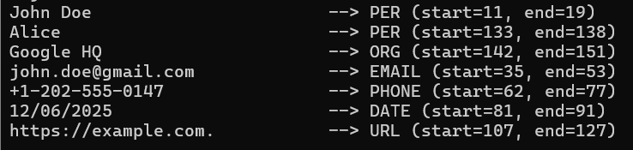
BERT + Regex Hybrid Approach
from transformers import pipeline
import re
def hybrid_entity_recognition(text):
# 1. BERT-based NER
ner_pipeline = pipeline("ner", model="dslim/bert-base-NER", aggregation_strategy="simple")
bert_entities = ner_pipeline(text)
# Standardisasi key dari BERT ke format seragam
standardized_bert_entities = [
{
"entity": ent["entity_group"],
"word": ent["word"],
"score": ent["score"],
"start": ent["start"],
"end": ent["end"],
}
for ent in bert_entities
]
# 2. Regex-based NER
regex_patterns = {
"EMAIL": r"[a-zA-Z0-9._%+-]+@[a-zA-Z0-9.-]+\.[a-zA-Z]{2,}",
"PHONE": r"\+?\d{1,3}[-\s]?\d{3}[-\s]?\d{3}[-\s]?\d{4}",
"DATE": r"\b\d{1,2}[/-]\d{1,2}[/-]\d{2,4}\b",
"URL": r"https?://[^\s]+",
}
regex_entities = []
for label, pattern in regex_patterns.items():
for match in re.finditer(pattern, text):
regex_entities.append({
"entity": label,
"word": match.group(),
"score": 1.0, # Regex tidak pakai probabilitas
"start": match.start(),
"end": match.end(),
})
# 3. Gabungkan hasil BERT + Regex
all_entities = standardized_bert_entities + regex_entities
return all_entities
# ==== Contoh Pemakaian ====
texts = [
"My name is John Doe, contact me at john.doe@gmail.com or call +1-202-555-0147 on 12/06/2025. My website is https://example.com. Meet Alice at Google HQ.",
"My name is Ahmad Putra. You can contact me at andi@gmail.com or call me at +628123456789.I want to apply for Informatics at University of Indonesia.The exam will be held on 12/06/2025 and the fee is Rp 500.000.",
"Saya ingin mendaftar di Universitas Indonesia jurusan Informatika, tapi saya tinggal di Bandung."
]
for text in texts:
entities = hybrid_entity_recognition(text)
for ent in entities:
print(f"{ent['word']:<30} --> {ent['entity']} (start={ent['start']}, end={ent['end']})")
print ()
Use BERT for complex entities (Person, Org, Location)
Use Regex/Dictionary for fixed formats (Email, Phone, Date, URL)
"My name is John Doe, contact me at john.doe@gmail.com or call +1-202-555-0147 on 12/06/2025. My website is https://example.com. Meet Alice at Google HQ."

Slide 15
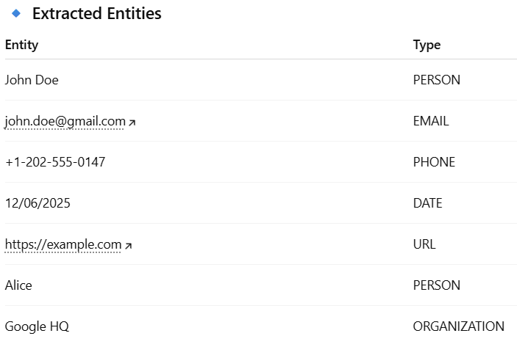
LLM for Entity Recognition
Create prompt
Send the prompt to LLM
Get the result
text = "My name is John Doe, contact me at john.doe@gmail.com or call +1-202-555-0147 on 12/06/2025. My website is https://example.com. Meet Alice at Google HQ.“
# Prompt manual
prompt = f"Extract entities (PERSON, EMAIL, PHONE, DATE, URL, ORGANIZATION) from the following text: {text}"

Slide 17
Bagaimana mengetahui library yang dibutuhkan oleh spacy?
$ pip show spacy

